Slide 1
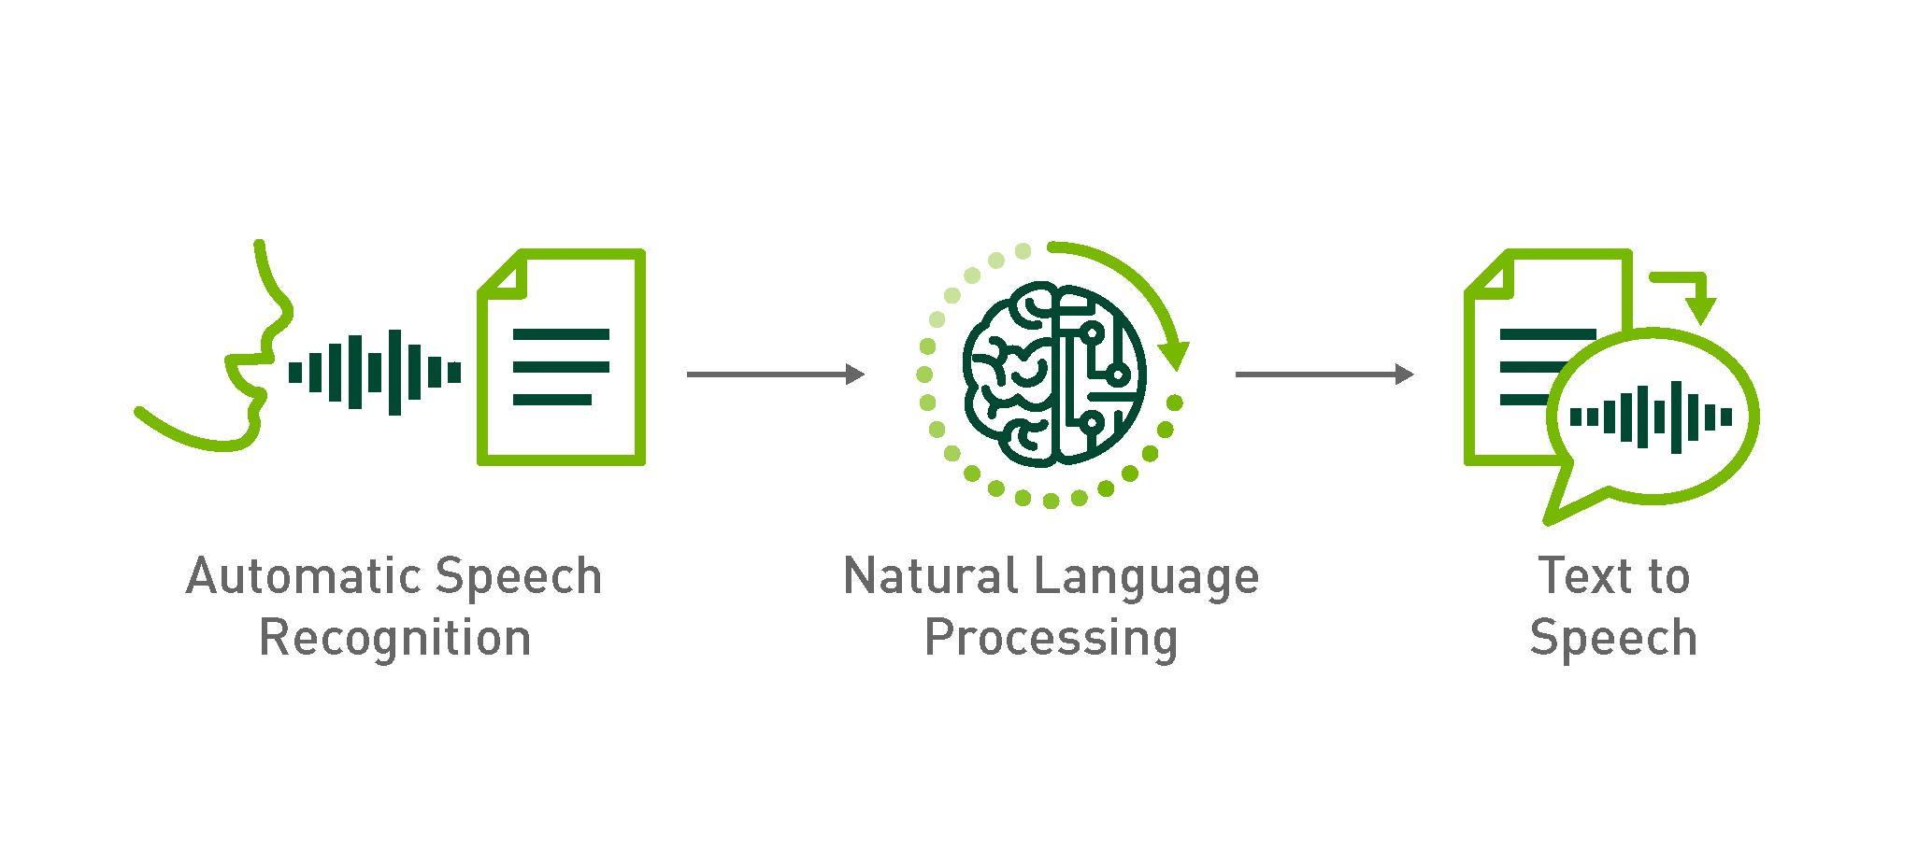
Speech-To-Speech LLM Bot

Slide 2
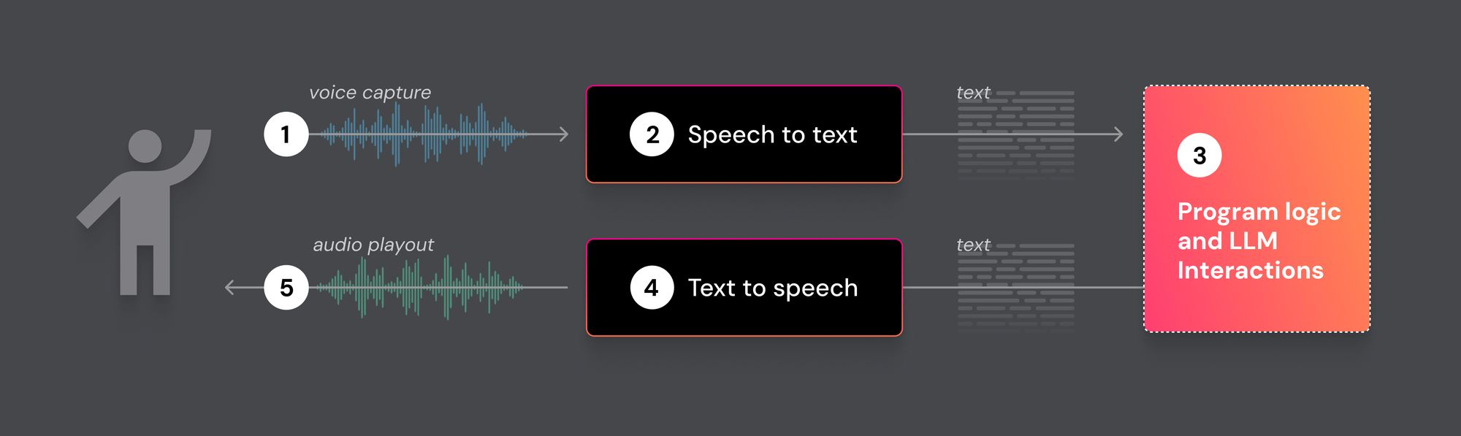

Slide 3
Start
User Speech
Microphone Capture
Speech Recognition
LLM processing and
Response generation
Text-to-speech
Audio Output
User
End

Slide 4
LLM stands for Large Language Model. It's a type of artificial intelligence model designed to understand and generate human language.
LLM Models
GPT-3.5 / GPT-4
(Open AI)
BERT
(Google)
T5
(Google)

Slide 5
Selection of Technologies
SpeechRecognition – To convert spoken language into text.
Pyttsx3 - Convert text to speech.
OpenAI GPT-3 / GPT-4 - Generate contextually relevant text responses.
OpenCV - Capture video input from webcam.
Pyaudio - Capture and play audio.
Flask - Web-based interface development.
PyQt - Advanced GUI development.

Slide 6
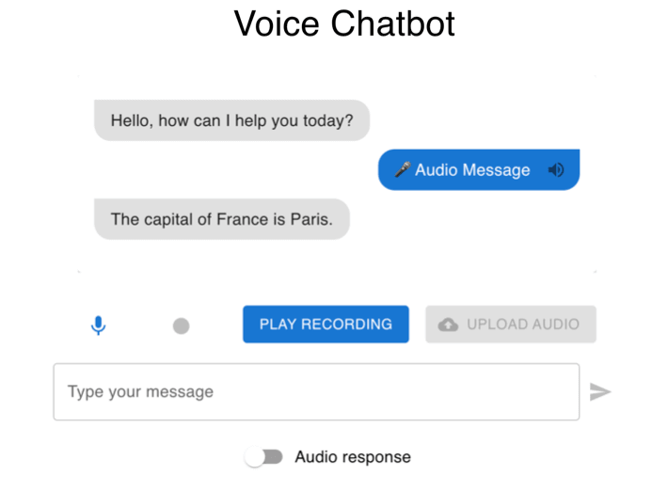

Slide 7
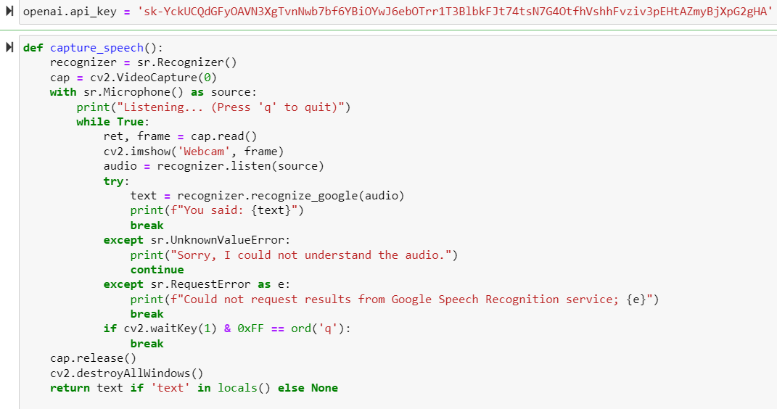
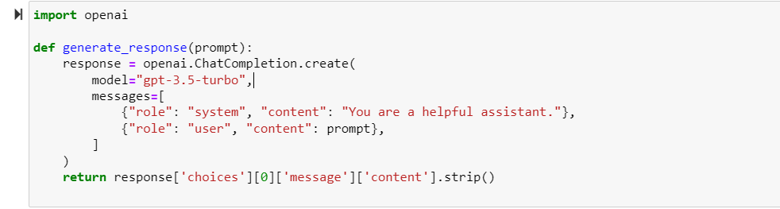

Slide 8
Potential Challenges and Solutions
Background Noise – using real-time noise suppression algorithms
Multilingual input - Use models or APIs that can automatically detect the language of spoken input
3-sec processing window – Parallel processing and asynchronous operation,
Minimizing unnecessary processing,
Optimizing the LLM processing

Slide 9
THANK YOU

